Slide 1
“Face recognition attendance system ”
Mini Project – IV (20ECL59B)
Danush Pravin 1NH20EC038
Disha Nayak 1NH20EC047
Guided By
Ms. Salna Joy
Assistant Professor
Dept. of ECE
New Horizon College of Engineering, Bengaluru

Slide 2
Contents
Introduction
Literature Review
Existing System
Problem Statement & Objectives
Proposed System
Block Diagram
Hardware & Software Specification
References
Progress Work
Milestones/Schedule/Timeline

Slide 3
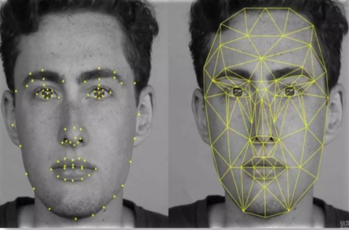
Introduction
Face recognition is a method of identifying or verifying the identity of an individual using their face.
Face recognition systems can be used to identify people in photos, video, or in real-time.

Slide 4
Literature Review
Title of the paper | Author & Year of Publication | Outcome | Limitation

Slide 5
Existing System
Traditionally, attendance is maintained in registers with a grid of small squares, making it difficult to read and tally.
Tedious Report Generation Process
In the present attendance management system, the report generation is quite lengthy and challenging as more calculations are required.
Manual Calculation
In the present state, all the calculations are done manually. This increases the probability of committing errors.
Manual Data Management
The existing attendance management system demands a lot of paperwork. It is hard to maintain so much handwritten data. Thus, it takes a lot of time to retrieve data.

Slide 6
Problem Statement & Objectives
Problem Statement:
To build a face recognition system using ESP32-CAM and Python.
Objectives:
Using face recognition to make school attendance systems more convenient.

Slide 7
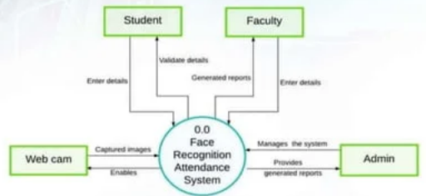
Proposed System
Face recognition attendance system is developed for the faculty to maintain attendance record.
It uses facial recognition technology to identify the person's facial features and automatically mark attendance which is very fast enough than previous method.

Slide 8
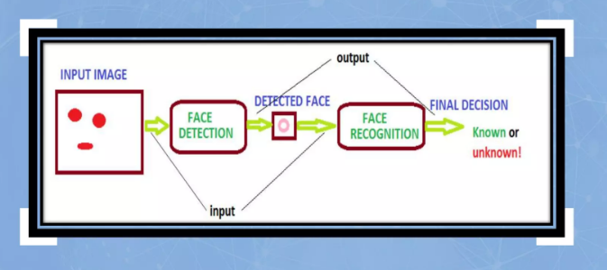
Block Diagram

Slide 9
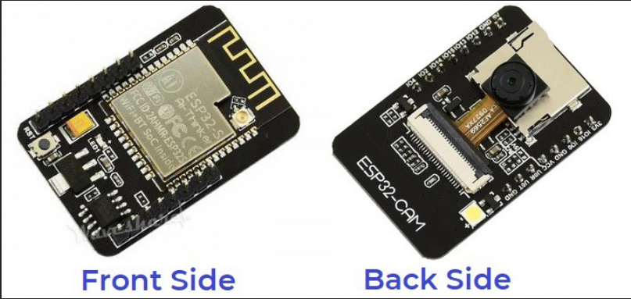
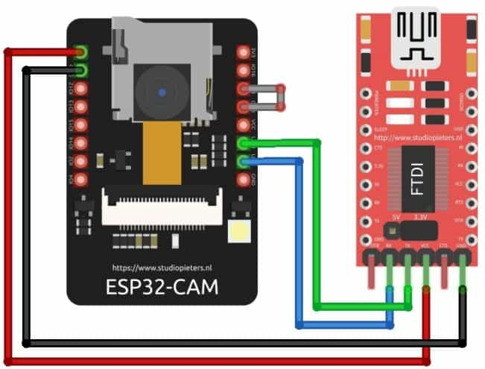
Hardware & Software Specification
1. ESP32-CAM
2. ESP32-CAM FTDI CONNECTION

Slide 10
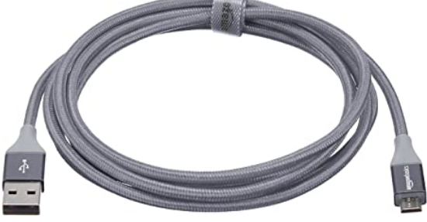
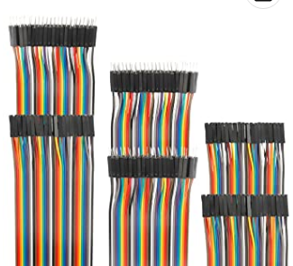
Hardware & Software Specification
3. MICRO USB CABLES
4. JUMPER WIRES

Slide 11


Hardware & Software Specification
1. Arduino IDE
2. Python

Slide 12
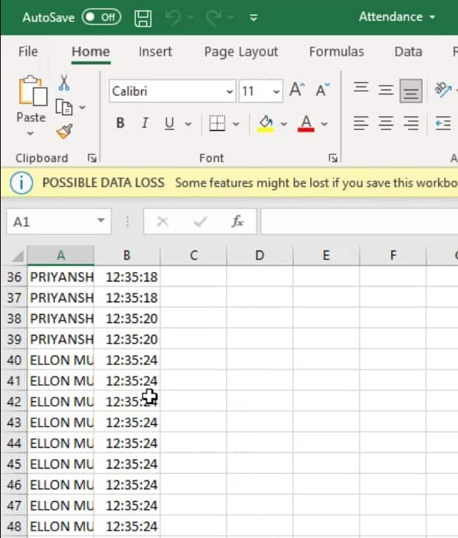
Expected Results
Detects the students and stores the data in an Excel sheet.

Slide 13
Applications
School attendance systems
Finding missing persons
Solving retail crime
Security identification
Identifying accounts on social media
There are several methods to perform facial recognition depending on the performance and complexity.

Slide 14
References
[1] D. W. Bliss, P. A. Parker, A. R. Margetts, "Simultaneous transmission and reception for improved wireless network performance", Statistical Signal Processing 2007 IEEE/SP 14th Workshop on, pp. 478-482, 2007.

Slide 15
Progress Work

Slide 16
Milestones/Schedule
Milestone | Baseline Date | Target Date | Achievement

Slide 17
Thank You

